Slide 1


GREEN CITY.AI
Forecasting Sustainable Future

Slide 2

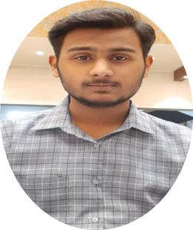

INTRODUCTION
Hi, I'm Zain Ali
Project Lead, Green City AI
I am Zain Ali Siddiqui, a final-year BS-CS student at FAST NUCES Karachi and Co-Founder & CEO of GreenCity.AI. Driven by a passion for innovation and sustainability, I aim to use AI to create smarter, greener energy solutions.

Slide 3






THE PROBLEMS
Unpredictable Nature Of Renewable Energy Production
Reliance On Fossil Fuels & Carbon Footprints
Renewable energy sources such as wind and solar can fluctuate by up to 30% depending on weather changes, creating grid reliability issues
Globally, fossil fuels remain dominant, making up around 80% of primary energy consumption and responsible for nearly 75% of global CO2 emissions.
Rising Electricity Prices & Lack Of Consumer Control
Energy Wastage
10%-15% of electricity is globally wasted due to mismanagement causing shortfalls that cost the Pakistani energy sector millions annually.
Prices for electricity have surged 155% since 2021 in Pakistan alone, yet consumers remain with little means of controlling and managing their own use.

Slide 4


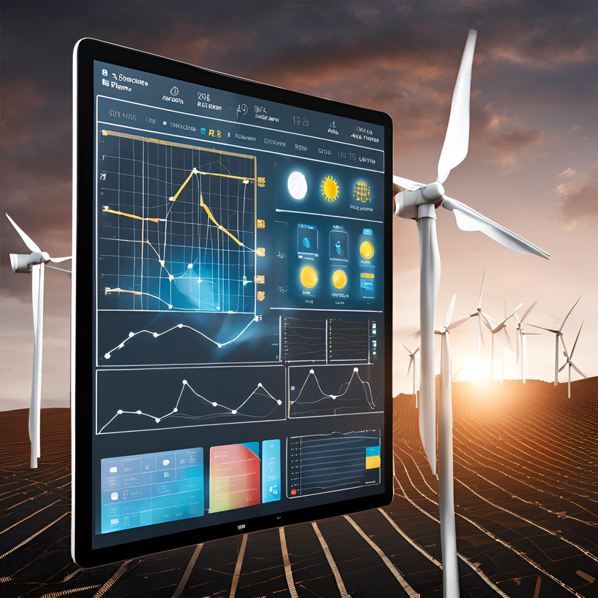

SOLUTION
Our AI Driven Approach- Software
AI Climate Based Wind Energy
Power Generation Forecasting
Electricity Demand Forecasting
Through Analysis & AI
Climate Based Electricity Supply vs Demand Forecasting Using AI
By integrating forecasting, utilities and consumers alike can save energy and reduce wastage. Consumers can save up to 20% on their energy costs, while grid-wide forecasting can reduce 10-30% of overall energy waste. This creates a more efficient, cost-effective, and sustainable energy system.

Slide 5



PRODUCT FEATURES & IT’S BENEFITS
Al-Driven Energy Forecasting
Location-Specific Recommendations
BENEFIT: Predict solar and wind energy generation with up to 90% accuracy, reducing energy wastage by 10-15% and improving reliability for green energy integration
BENEFIT: Identify optimal renewable sources and turbine types tailored to local climates, increasing energy output by up to 20% through improved resource utilization
Demand-Supply Balancing
Dynamic Pricing Model
BENEFIT: Align renewable energy generation with consumption needs, potentially reducing fossil fuel reliance by up to 30% during peak demand periods
BENEFIT: Offer flexible pricing based on renewable energy availability, enabling consumer savings of 10- 20% on electricity bills
Consumer Empowerment App
BENEFIT: Provides real-time energy monitoring, budget control, and cost-saving insights for users that helps consumers achieve energy cost reductions of up to 15%.

Slide 6
MARKETING STRATEGY
01.
02.
03.
04.
Partnerships & Outreach
Demos & Digital Presence
Free Trials & User Onboarding
Rewards & Incentives
Strategic partnerships with energy providers, renewable energy organizations, and educational campaigns.
Demos at renewable energy events and digital engagement with social media.
Free trials and user onboarding to build trust and educate early adopters.
Loyalty rewards, in-app incentives, and referral programs to foster long-term use.

Slide 7
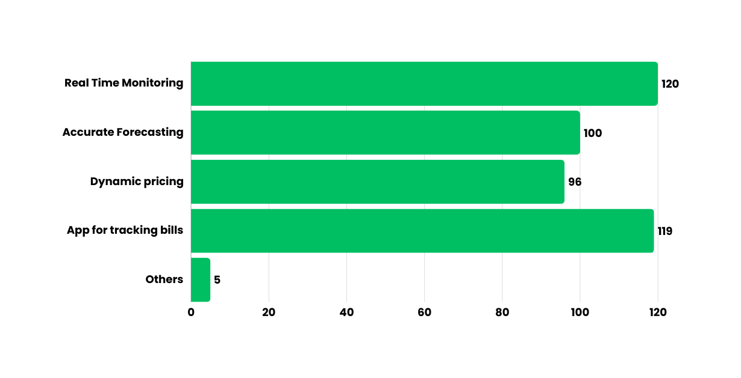

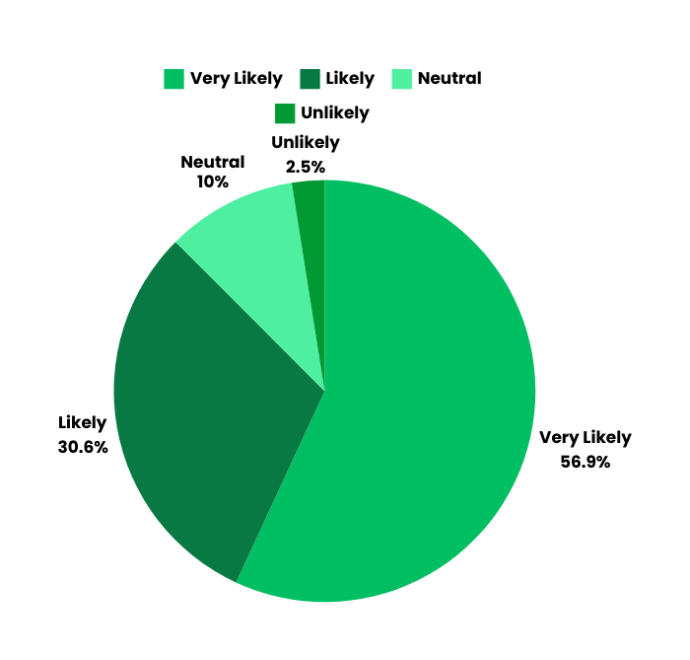
MARKET VALIDATION
Personalized survey conducted to analyze user response to our product
Would you be more likely to support my product in the market?
Platform Used: Google Forms
Total No. of Participants: 160

Slide 8



BUSINESS MODEL
Subscription Plans
Data Analytics Sales
Monthly & Annual Option For:
•Household
•Businesses
•Smart Cities / Government
Selling Energy Insights and Management strategies to individuals, groups & Government.

Slide 9





MARKET OPPORTUNITY
Pakistan’s RE Potential
Pakistan’s Renewable Goals
Growing Initiatives
Smart Energy Management
Pakistan has strong solar (2.9 million MW) and wind (346,000 MW) potential, ideal for renewable energy innovation.
Currently at 5%, Pakistan aims for 30% renewable energy by 2030.
Pakistan’s renewable energy sector is estimated at
$40 Billion by 2030, with over $2 Billion already invested.
The global smart energy market is projected to grow to $60 Billion by 2030, with Pakistan emerging as a key player

Slide 10
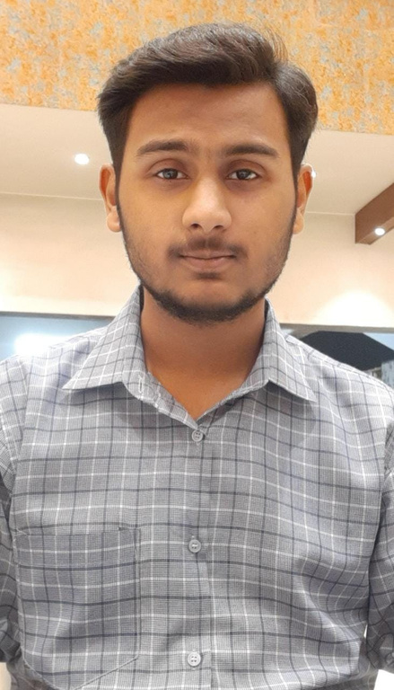
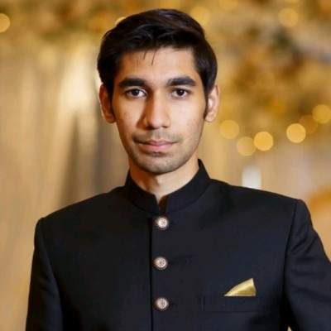
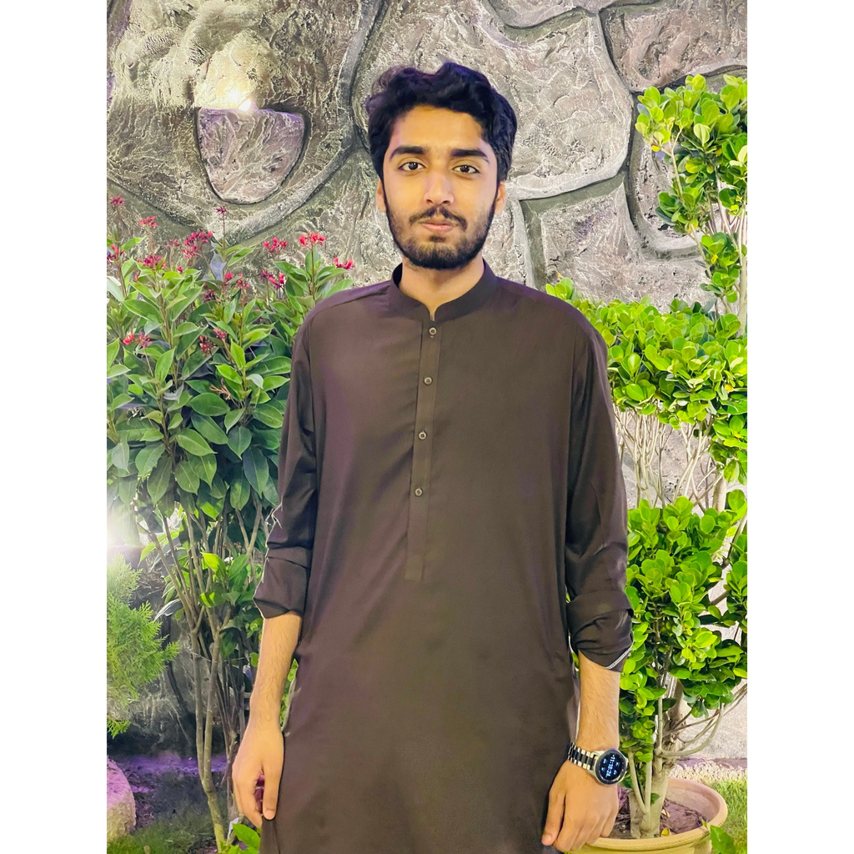

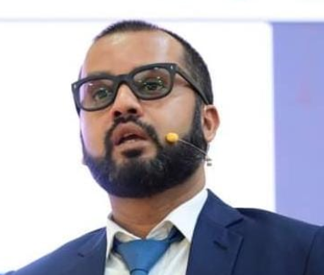

OUR TEAM
Zain Ali Siddiqui
M.Maaz Khan
Abdul Rehman Arain
Co-Founder & CEO
BS(CS)-4th Year
Co-Founder
BS(CS)-4th Year
Co-Founder
BS(CS)-4th Year
Ms Saeeda Kanwal
Dr M.Farrukh Shahid
Supervisor
Co Supervisor

Slide 11


THANKYOU
Any Question, Just Ask

